Slide 1
Chapter Two
At the end of this chapter you will understand:
1. Asexual reproduction
2. The steps to asexual reproduction
3. Sexual reproduction
4. Meiosis and the steps to meiosis
5. How traits are passed from parent to offspring.
6. How mutations occur.

Slide 2
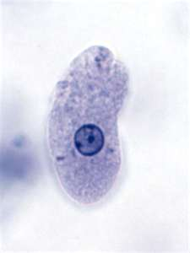
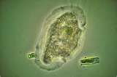
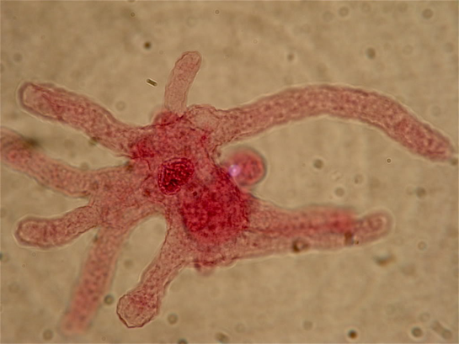
Asexual Reproduction
--reproduction by one parent
Ex. amoeba

Slide 3
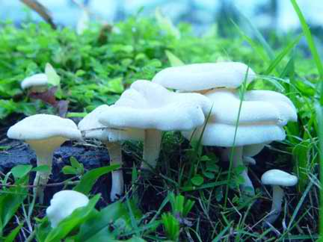
Steps to asexual reproduction
1. Parent cell makes 2 identical copies of DNA
2. Parent cell goes through mitosis & cell division
3. Each new offspring cell receives one of these identical sets of DNA

Slide 4
Stop and think!!!!
Do the offspring of asexual reproduction share the same traits?
What would happen if we reproduced through asexual reproduction?

Slide 5
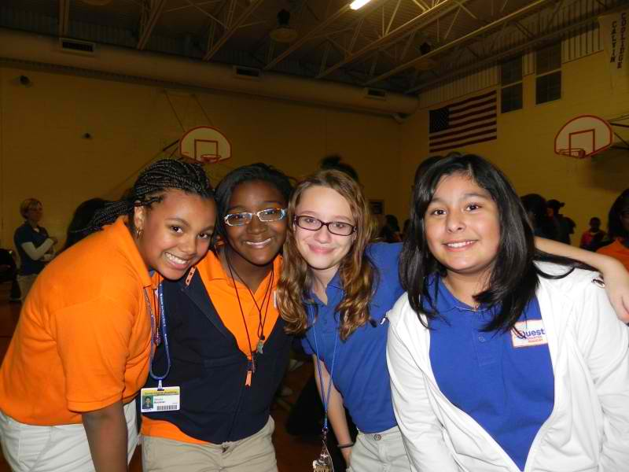

Slide 6
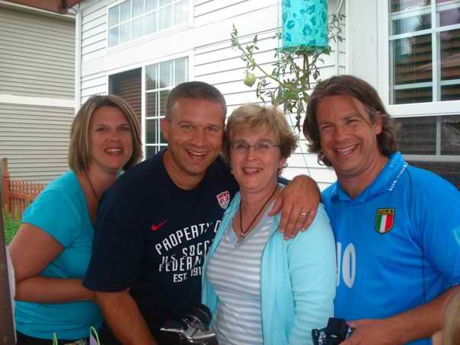
Sexual Reproduction
1. Reproduction by 2 parents
2. Offspring are not exactly like either parent

Slide 7
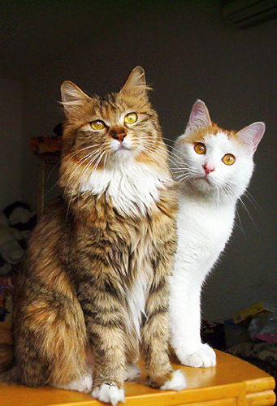
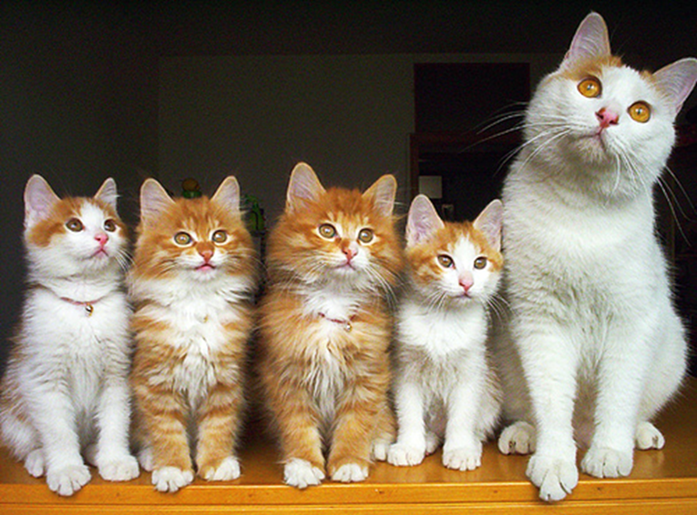
Activity Time
Look at the family of cats. List traits the kittens share with their parents.

Slide 8
Stop and think!!!!
List some differences in traits that are easy to see.
List some differences in traits that are hard to see.

Slide 9
Organisms that produce offspring by sexual reproduction reproduce through sex cells.
Sex cells are formed during:
MEIOSIS!!!!

Slide 10
Egg Formation
1. Parent cell copies DNA.
2. Cell goes through mitosis.
3. Cells go through meiosis and divides a second time.

Slide 11
Egg Formation
Parent
Cell
DNA copies itself
offspring
cells
Mitosis
offspring
cells
Egg
cell
Egg
cell
Egg
cell
Egg
cell

Slide 12
Sperm Formation
1. Parent cell copies DNA.
2. Cell goes through mitosis.
3. Cells go through meiosis and divides a second time.

Slide 13
Sperm Formation
Parent
Cell
DNA copies itself
offspring
cells
Mitosis
offspring
cells
Sperm
cell
Sperm
cell
Sperm
cell
Sperm
cell

Slide 14
Stop and think!!!!
How many chromosomes are in each egg or sperm cell?

Slide 15
Fertilization
1. Sperm cell enters egg cell
2. Chromosomes from both cells pair up.
3. This first cell of the new offspring now has a complete set of DNA.

Slide 16
Stop and think!!!!
Do you think that a trait might appear in a grandparent and a grandchild but not in the parent?

Slide 17
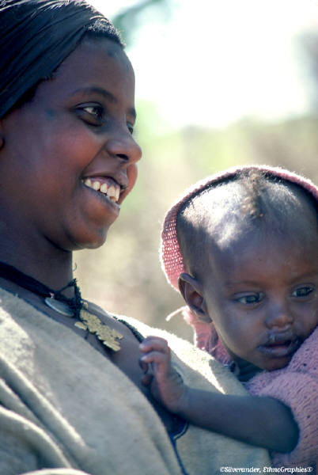
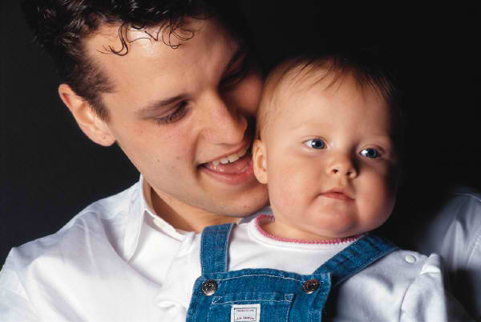
Inherited Traits
1. In plants and animals, offspring inherits at least 2 genes for every trait.
1 from mom
1 from dad

Slide 18
Dominant Genes
Gene that hides the effect of another gene
Dominant gene represented by capital letter
Note: Dominant gene controls a trait whenever a dominant gene and a recessive gene pair together.

Slide 19
Recessive Genes
Gene whose effect is hidden by a dominant gene.
Recessive genes represented by lower case letter.

Slide 20
Stop and think!!!!
Which trait is a dominant gene? Which trait is a recessive gene?
R = rough fur
r = smooth fur
If an offspring received a gene for smooth fur and a gene for rough fur, which type of fur would it have?

Slide 21
Purebred
Organism has 2 genes of the same trait
Ex. RR (2 rough fur)
rr (2 smooth fur)
Hybrid
Organism with 1 dominant gene & 1 recessive gene
Ex. Rr (1 rough fur & 1 smooth fur)

Slide 22
Punnett Square
Used to determine possible traits an offspring can have if a mom & dad mate.
Mom RR= rough fur (purebred)
Dad rr = smooth fur (purebred)
R
R
r
r

Slide 23
Activity Time
Make your own kid.

Slide 24
Activity Time
Sponge Bob Worksheet.

Slide 25
Mutations
Permanent change in DNA that occurs when DNA copies itself.
Happens by chance when DNA copies itself.
Some changes not even noticed.
Some changes result in a trait that has never been seen before.

Slide 26
The change can be:
Whole section of DNA rearranged.
An A, T, C, or G is out of place.

Slide 27
Stop and think!!!!
Is a mutation always harmful?
What would happen if an individual with the mutation survives long enough to reproduce?

Slide 28
Albinism (Albino)
Cannot make melanin which gives color to skin, hair, feathers, eyes.
Albino organisms are usually colorless.
Ex. Albino chipmunk, albino snake, snow-white peacock

Slide 29
Stop and think!!!!
Why don’t albinos survive very well?

Slide 30
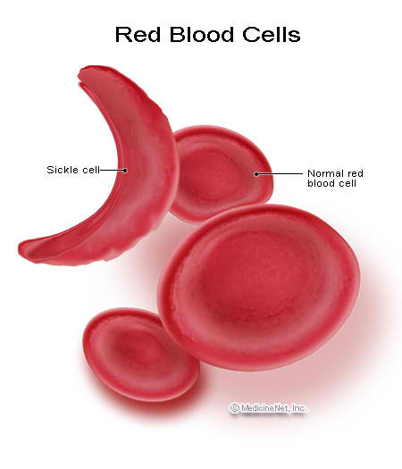
Sickle Cell
Affects the shape of a red blood cell which can effect the person’s health
Sickle
Normal

Slide 31
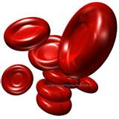
If have 2 normal genes:
Cells are round.
They carry oxygen to the body tissues.
NO Blood Disease!!!!

Slide 32
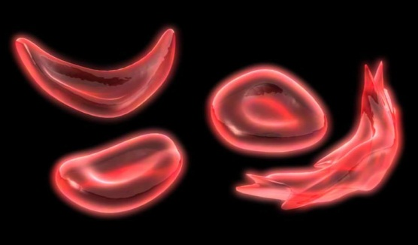
If have 1 normal & 1 mutant gene:
Some cells are round & some are sickle shaped.
Sickle-cells do not carry
oxygen well.
NO Blood Disease!!!!
Resistance to malaria!!!!

Slide 33
If have 2 mutant genes:
All blood cells are sickle shaped.
Sickle cells do not carry enough oxygen to body tissues
Have sickle cell anemia
People feel weak.
Not treated, causes death at a young age!

Slide 34
Stop and think!!!!
If you consider the effects of sickle-cell genes on the red blood cells, do you think having one mutant gene is helpful, harmful or no effect?

Slide 35
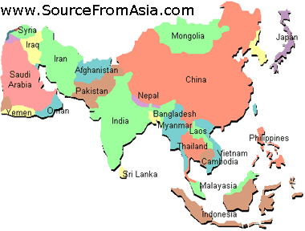
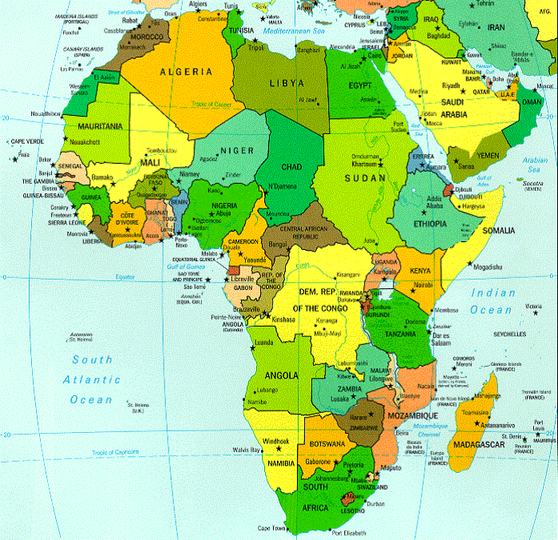
Stop and think!!!!
Why do you think the mutant gene has spread through the populations of Africa & Asia?

Slide 36
Let’s Review
Review Board Game

